Slide 1


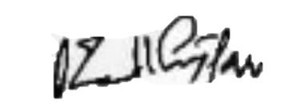
{QR_CODE}
Vishlesan i-HUB IIT Patna
CERTIFICATE OF PARTICIPATION
{CERTIFICATE_REF}
This is to certify that {PARTICIPANT_NAME} of {COLLEGE_NAME} has completed the Faculty Development Program AI Mastery for Educators From 15 May, 2025 to 7 June, 2025
Dr. Sai Kiran CEO, Vishlesan i-HUB IIT Patna

